Slide 1
How Fast Does Light Travel in Water?
Hands-On Activity
Coordinating Seminar
Allison Cowan

Slide 2
Goals
Students will use various math skills to explore light’s behavior in water.

Slide 3
Objectives
Students will use the Pythagorean Theorem and relationship between distance, rate, and time to calculate the time it takes for light to travel from a point above water to a point below water.
Students will develop a function to graph the speed of light in water.

Slide 4
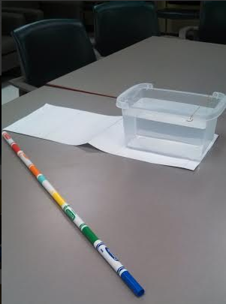
Student Materials
Clear Plastic Container of water prepared by the teacher
Wooden Dowel (or other thin cylinder that can be placed perpendicular to the table) with a mark 20 cm from the water level
Ruler
Pencil
Worksheet

Slide 5
Some Useful Formulas
$a^{2}+b^{2}=c^{2}$
Time = Distance ÷ Rate

Slide 6
Introduction
Have students read a passage about light
At the discretion of the teacher, it can be read as homework the night before or in the beginning of class

Slide 7
Introduction to Topic-Rationale
In a vacuum, light travels 30 cm/nanosecond
That is 186,281 miles per second
Light’s speed depends on the optical density of the material it is passing through
Basically, light moves slower through water than air
Fermat’s Principle: Light travels the path that takes the least amount of time to travel, not necessarily the shortest distance

Slide 8
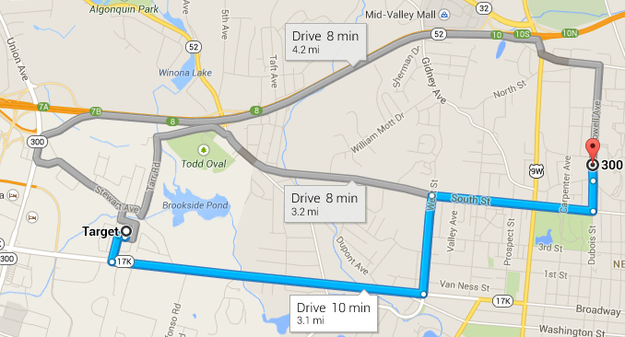

Slide 9
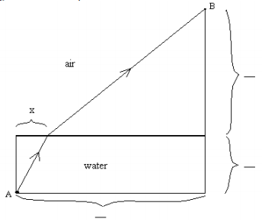
Question 1

Slide 10
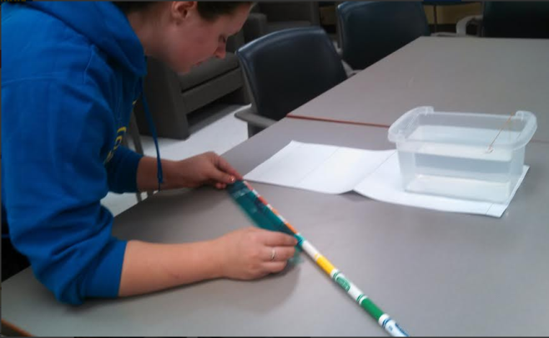
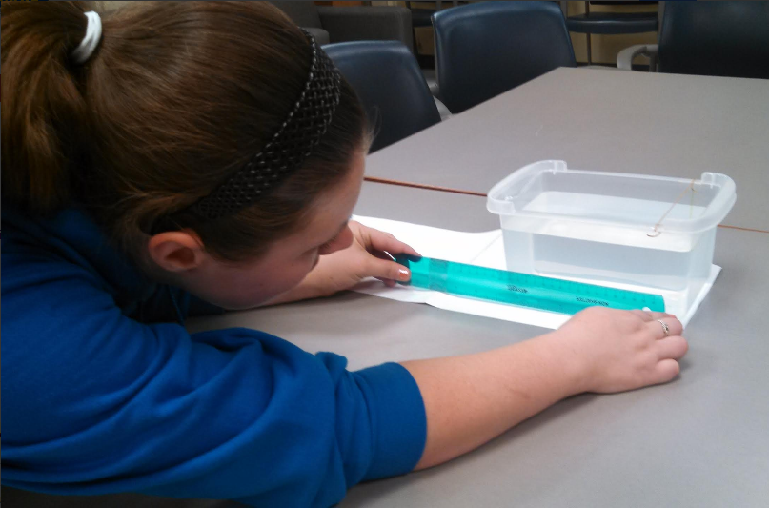
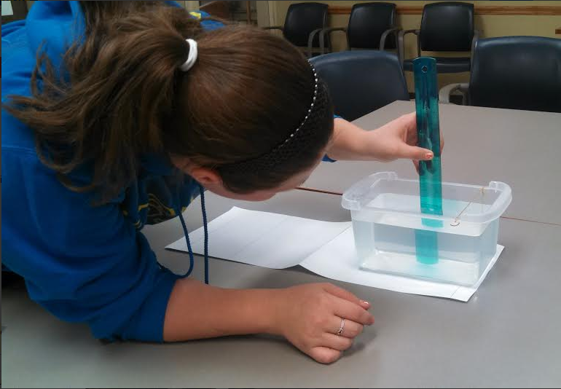
Question 1

Slide 11
Question 2
Assume light travels 15 cm per nanoseconds. (This is just used as an initial guess.) Find the length of time in nanoseconds it would take light to travel from Point A to Point B following the path…
…when x=1 cm.
…when x=5 cm.
…when x=10 cm.

Slide 12
Question 2 continued
In order to do this, students should break up the path light takes into two separate pieces: A to the water level, and B to the water level.
Students may need hints to find the answer:
How do you find the length of the hypotenuse of a right triangle?
How do you calculate the amount of time it takes to drive 120 miles if you are driving 60 mph?

Slide 13
Question 2 continued
When x=1: 2.3 nanoseconds
When x=5: 2.27 nanoseconds
When x=10: 2.06 nanoseconds

Slide 14
Question 3
For which value of x creates the best path?
The best path is when x=10 because it takes the least amount of time.

Slide 15
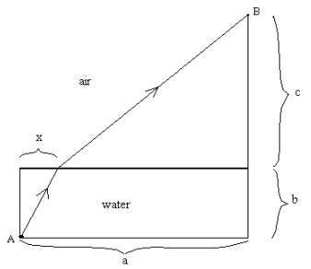
Question 4
Write a function, T(x), for the time it takes light to travel from A to B. Use 30 cm/nanosecond as light’s speed in air and 15 cm/nanosecond as light’s speed in water. Substitute in variables from the diagram below. *Remember 15 cm/nanosecond is only a guess until we can figure out x

Slide 16
Question 4 continued
$T\left(x\right)=\frac{\sqrt{x^{2}+b^{2}}}{15}+\frac{\sqrt{{(a−x)}^{2}+c^{2}}}{30}$

Slide 17
Question 5
Use your calculator to estimate the path light will take using the formula and measurements from number 4. (What is the x-value?)
x = 4

Slide 18
Question 5 continued
Does light actually take the path you found? If not, why not?

Slide 19
Question 5 continued
Does light actually take the path you found? If not, why not?
NO because the assumed value for light’s speed in water was probably wrong

Slide 20
Question 6
Now we can find the value of x. Put a ruler across the top of the container with zero lined up with the string. One person should hold a pencil point at th the surface of the water at the value you computed x to be in quester 5, and another person should be looking at the point from the point on the dowel. If the pencil doesn’t line up with the point, the observer should instruct their classmate to move the pencil until it does line up.

Slide 21
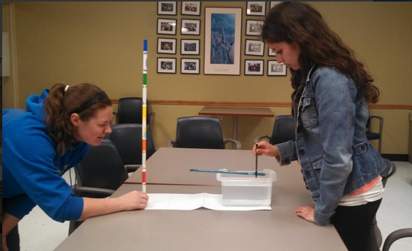
Question 6 continued
What measurement on the ruler does the pencil line up with? This is our x-value, or the distance from A at which light enters the water.
x = 7.5 cm

Slide 22
Question 7
We now have all the information we need to find the speed of light in water. Using the formula and keeping x as a variable, substitute different values for the speed of light until you get as close as possible to the actual x-value you measured. Once you get the actual x-value, you have found the speed of light underwater.
The speed of light is…?

Slide 23
Question 7 continued
My calculations gave:
22.75 cm per nanosecond
The actual speed of light underwater is: 22.5 cm per nanosecond

Slide 24
Question 8
How did you use math to approximate the speed of light in water?

Slide 25
Extension Activity
Using the same set-up as before, fill the container to a different depth than before. Use the result your class got for the speed of light in water to predict where you would see the object; that is predict the value of where the path of light emerges from the water. Then observe as before to see where it actually emerges. Comment on your result and explain it.

Slide 26
Activity and Materials Adapted From:
http://www9.georgetown.edu/faculty/sandefur/handsonmath/downloads/pdf/light-t.pdf
http://www9.georgetown.edu/faculty/sandefur/handsonmath/downloads/pdf/light-s.pdf

